Slide 1








Lindsworth School
Safeguarding Newsletter
Spring Term
In today's digital world, group chats on platforms like WhatsApp, Snapchat, and others have become a common way for children to stay connected.
The realities of group chats Group chats are often viewed as harmless, but they can expose children to risks parents might not anticipate. These digital spaces can quickly become environments where negative behaviours thrive without adult supervision.
Many parents are unaware of what can occur in group chats. Unfortunately, children can be exposed to: Unkind behaviour: teasing, exclusion, and bullying can occur more easily behind a screen.
Inappropriate content: children may encounter or share inappropriate language, images, videos, or other harmful content.
Peer pressure: children may feel pressured to participate in conversations they are uncomfortable with. Over use and distraction :constant notifications can interfere with sleep, homework, and family time. How can parents help?
As a parent, there are practical steps you can take to educate and monitor your child's use of group chats: Have open conversations: talk to your child about the importance of kindness, respect, and the impact of their words online. Set boundaries: establish rules around screen time and appropriate online behaviour. Monitor group chats: regularly check the content of your child’s chats and discuss any concerning messages.
Teach privacy awareness: encourage your child to think before sharing personal information or images. Promote reporting: let your child know they can come to you if they feel uncomfortable or witness inappropriate behaviour. Use parental controls: utilise built-in tools on devices and apps to limit access and monitor usage.
Do you have X? (Twitter)
Find our school to see what we’re up to , shout outs to specific pupils and more! @lindsworthsch
At Lindsworth School we have PRIDE
Positivity > Respect > Independence > Determination > Equality

Slide 2
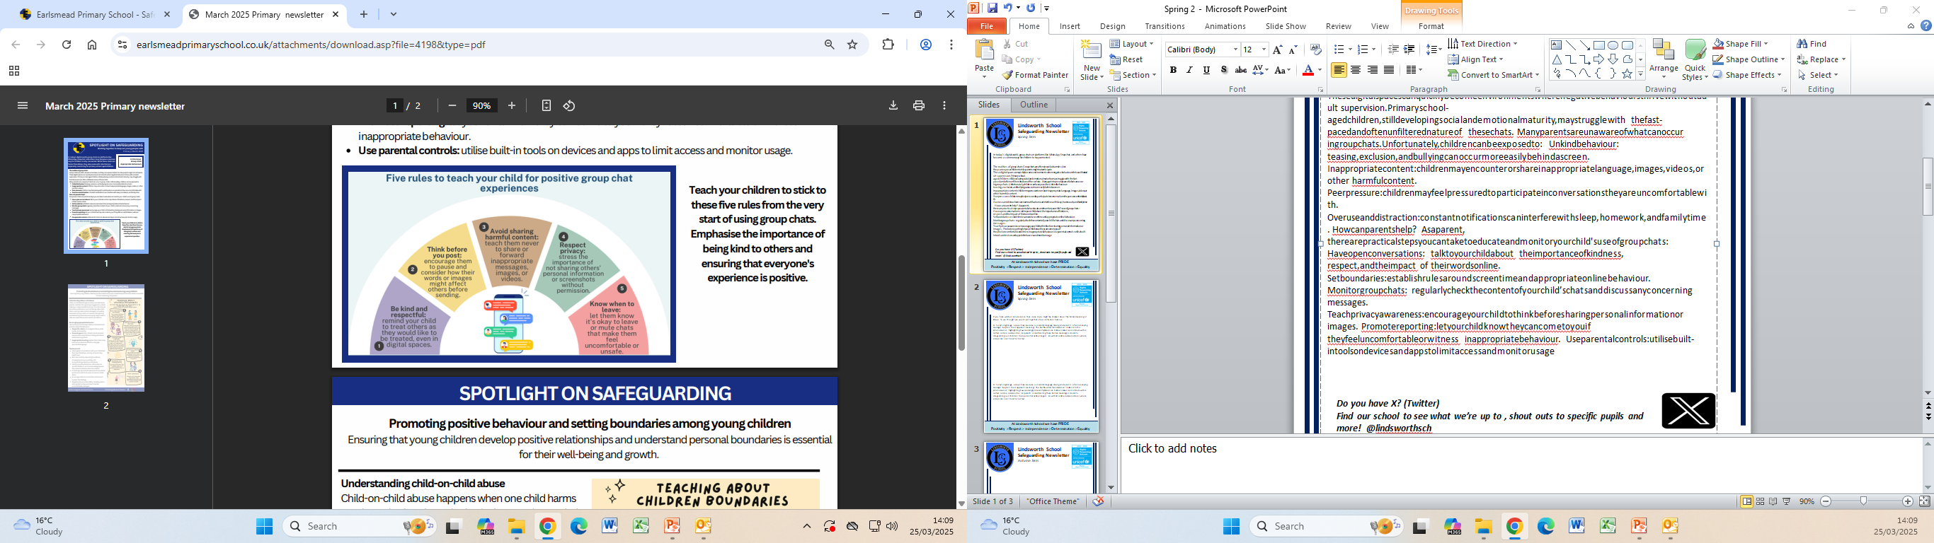
Lindsworth School
Safeguarding Newsletter
Spring Term
If you have watched Adolescence then some of you might be shocked about the hidden meaning of Emojis. So we thought we would put together a few useful ones to know.
In today’s digital age, emojis have become a universal language among adolescents, often conveying messages beyond their apparent meanings. The Netflix series “Adolescence” delves into this phenomenon, highlighting how seemingly innocent symbols can harbor darker connotations within certain online communities. As parents, understanding these hidden meanings is crucial to safeguarding our children from potential online dangers. ￼As with all online communications where emojis are used look for context.
In today’s digital age, emojis have become a universal language among adolescents, often conveying messages beyond their apparent meanings. The Netflix series “Adolescence” delves into this phenomenon, highlighting how seemingly innocent symbols can harbor darker connotations within certain online communities. As parents, understanding these hidden meanings is crucial to safeguarding our children from potential online dangers. ￼As with all online communications where emojis are used look for context.
At Lindsworth School we have PRIDE
Positivity > Respect > Independence > Determination > Equality

Slide 3
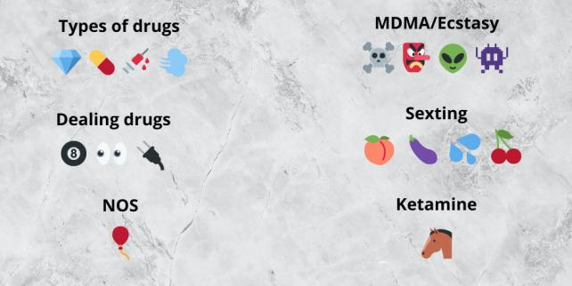
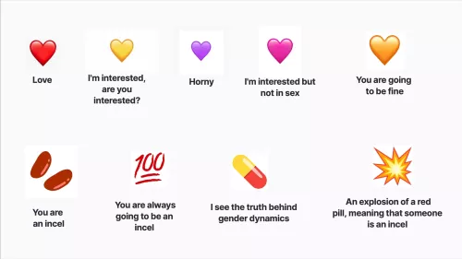
Lindsworth School
Safeguarding Newsletter
Autumn Term
At Lindsworth School we have PRIDE
Positivity > Respect > Independence > Determination > Equality

